Slide 1

Capstone – News Article Classification Design & Approach
KrupaSindhu & Dayakar

Slide 2





News Article Classification – Architecture Design In-Detail View
Optimization of ML Model based on new Raw Data Feed
Scheduler
Source1
Source Connector
Producer
ML Model
Train
Predict
Front End News Classifier
RSS Feed / REST APIs
Topics (Web Scrapping)
Source2
Consumer
Sink Stream
Data Extraction
Data Cleansing
Data Preparation
Model building
Model evaluation
Tokenizer
HashingTF
Modeling
Raw text
Words
Feature Vectors
Predictions

Slide 3
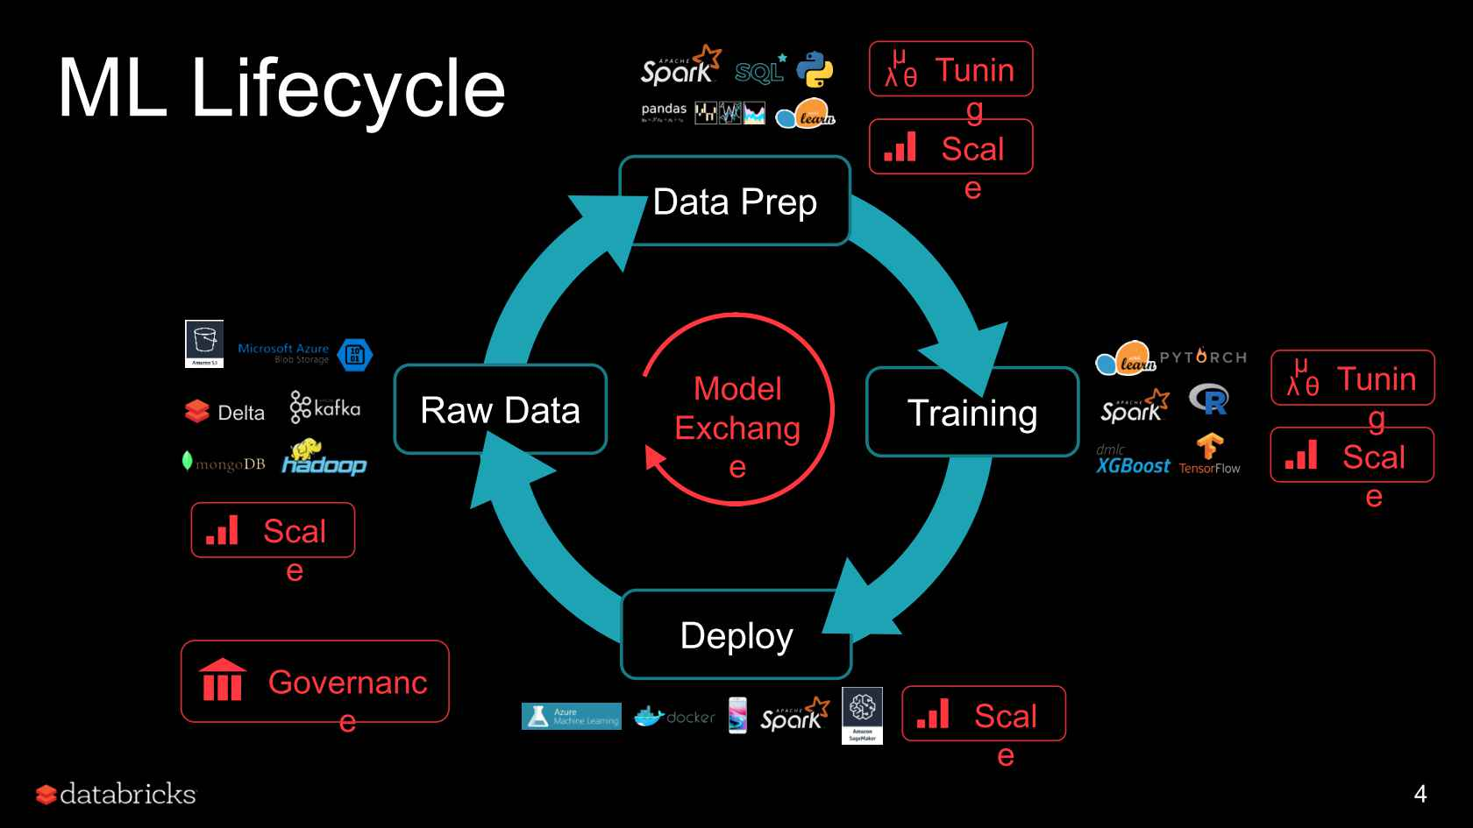
News Article Classification – ML Life Cycle

Slide 4
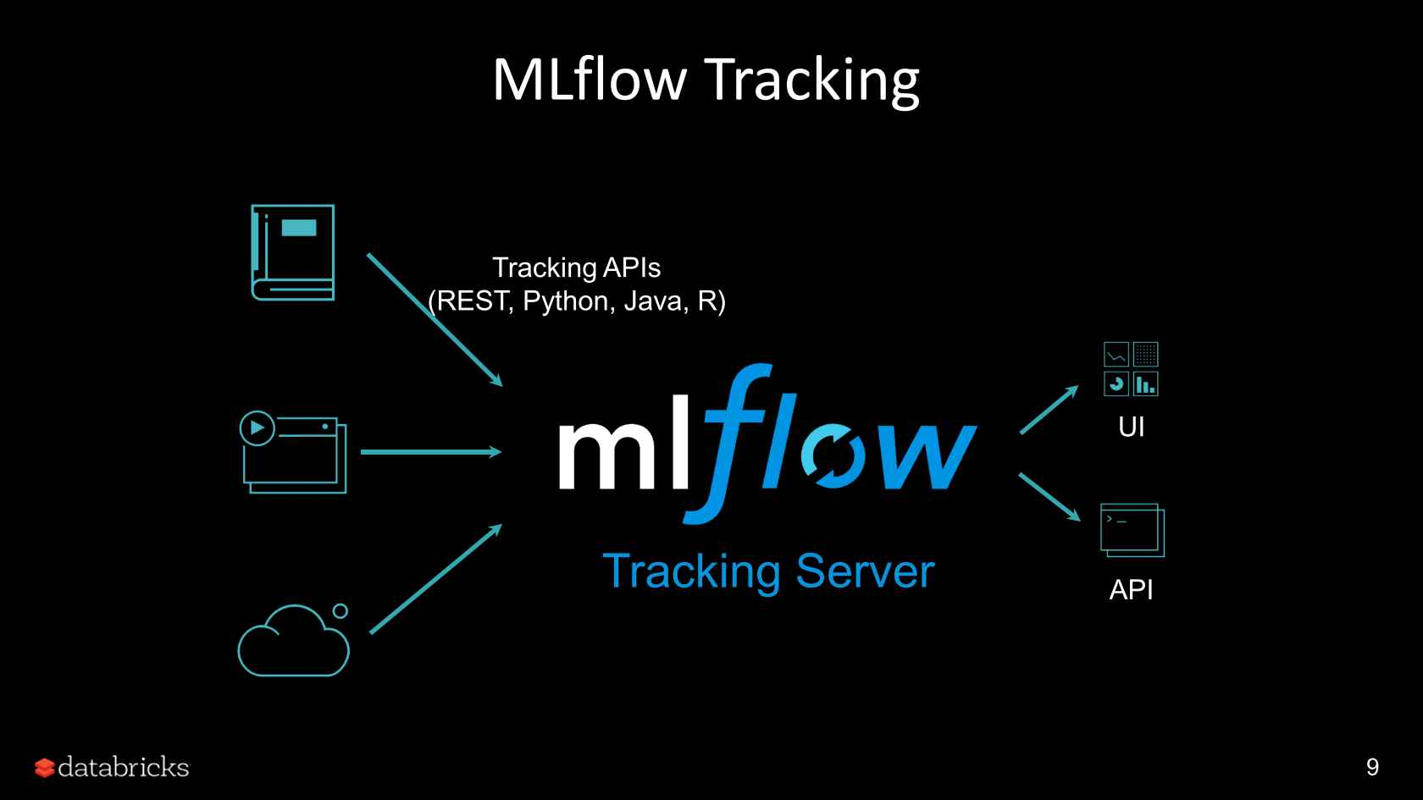
News Article Classification – ML Flow

Slide 5
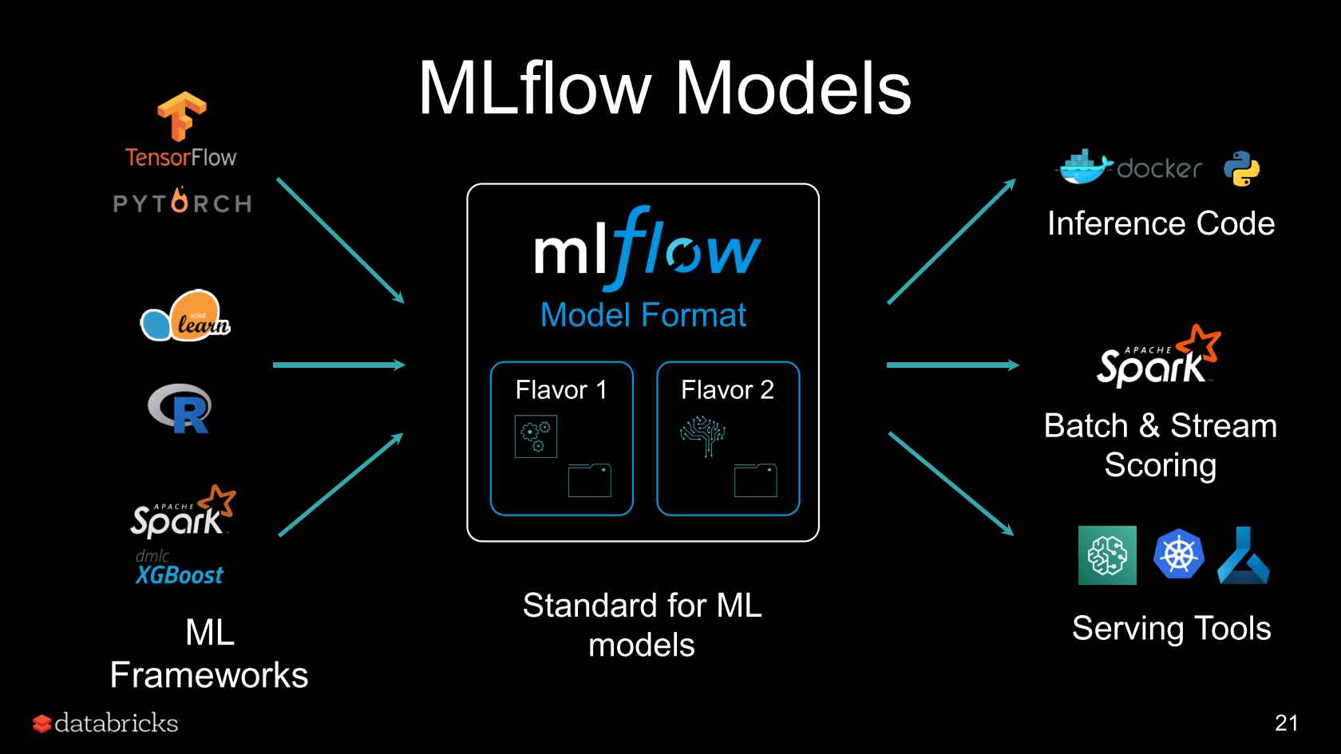
News Article Classification – ML Ops

Slide 6
News Article Classification – ML Approach
Data Preparation
Model Deployment & Prediction
Data Ingestion
Data Segregation
Release
Data preprocessing
Dataset Loading via MongoDB
Data Presentation
Understanding the Dataset
Transform Raw data
Understanding Target Variable
PCA
Data Cleansing
Segregation of Train & Test Datasets
Flask API integrated data segregation
Serialization
Understanding Hyper params
Model Implementation
ML Flow & ML Registry
Docker Implementation
Model Training
Model Evaluation
Flask API
GitHub
Dockerization
Model Prediction via inputs through HTML Webpage

Slide 7
News Article Classification - Approach
Milestone 1
Python Set up
Milestone 2
Data Ingestion through MongoDB
Milestone 3
Data Segregation
Mileston 4
Model Prediction via flask API
Kafka Setup
MongoDB Setup
VSCode Setup
Dataset representation through PySpark
Set up Model Training
Data Cleansing
Data Transformation
Model Training & Deployment
Implementation of flask API
Serialize the Train Model
Integrate with ML Flow /PyFunc
Docker Integration & Implementation
HTML Webpage to source the input and display the predictions
Kafka & MongoDB for data streaming
Data ingestion
Web Scraping
Storing the data in MongoDB
Kafka streaming/Zookeeper

Slide 8
Appendix

Slide 9
News Article Classification – Architecture Design Overview
Scheduler
Source1
Source Connector
Producer
Connector
Producer
ML Model
Train
Predict
Front End News Classifier
RSS Feed / REST APIs
Topics (Web Scrapping)
Source2
Consumer
Consumer
Sink Stream
Sink Stream
Optimization of ML Model based on new Raw Data Feed

